Slide 1
2021-2022 Core Curriculum Resources and Aligned Professional Learning
- Office of Teaching and Learning -
Dr. Kimberly Smith, Executive Director
September 21, 2021

Slide 2
Mission
At Jackson Public Schools, we develop scholars through world-class learning experiences to attain an exceptional knowledge base, critical and relevant skill sets, and the necessary dispositions for great success.

Slide 3
Vision
At Jackson Public Schools, we prepare scholars to achieve globally, to contribute locally, and to be fulfilled individually.

Slide 4
JPS Commitments
A Strong Start Innovative Teaching and Learning Talented and Empowered Teams
Joyful Learning Environments
A Culture of Accountability and Excellence

Slide 5
JPS Core Values
Equity
Excellence
Growth Mindset
Relevance
Relationships
Positive and Respectful Cultures

Slide 6
Presentation Purpose
to articulate and explain the textbook adoption process
to articulate and explain the core curricula resources and their appropriate usage
to articulate and explain the professional learning aligned to effective implementation of the core curricula resources
to provide the instructional staff’s perspective on the use of core curriculum resources

Slide 7
JPS Core Curricula Selection Process

Slide 8
Curricula Selection Process
District Textbook Coordinator
Teachers
School Administrators
District Personnel
Lori Harris
Notes:
Ms. Lori Harris serves as the JPS District Textbook Coordinator and leads and develops the Textbook Selection Committee which consists of teachers, school administrators, and district personnel.

Slide 9
Curricula Selection Process
JPS District Textbook Committee is developed
Textbook vendors are chosen to present products
JPS Committee presents recommendations to the JPS Leadership Team
Selected materials are presented to the school board for approval
JPS Textbook Committee rates each presentation
Notes:
Textbook vendors present their products individually in a 45 to 60 minute presentations
The committee rates each presentation on features such as alignment to the MS-CCRS, accommodations for special populations, accessibility for teachers, integration to district level platforms, and relevance.
After scores have been tabulated, recommendations are made to the Sr. Leadership Team for feedback
Selected materials are presented to the board for approval.

Slide 10
JPS Core Curricula

Slide 11
Commitment 1: A Strong Start
Implement high-quality developmentally appropriate curriculum
Curriculum | Academic Content Area | Grade Band | Purpose of Implementation
Opening the World of Learning (OWL)® | Early Literacy | Pre-Kindergarten | develops oral language and early literacy skills provides guidance for teachers with a variety of materials to implement thematic units
Fundations® Foundational Phonics Curriculum | Foundational Skills (Literacy) | K-2 | guides students in phonemic awareness and word study contributes greatly to fluency, vocabulary development, and the applications of strategies for understanding text
Notes:
Fundations: reading/beginning reading skills and strategies: - Training September 3rd
Phonological awareness and phonemic awareness skills
Print awareness skills
Phonics and decoding
Word attack
Vocabulary development
Introduction of new words
Word-learning strategies
Academic vocabulary
Fluency
Accurate, fluent reading
Appropriate phrasing and expression
Rate
Comprehension (listening and written) strategies
Analyzing text and drawing conclusions/making inferences
Connecting text to personal experience and other text
Writing skills and conventions:
Spelling skills and conventions (rules and patterns)
Use of writing conventions such as use of capital and lowercase letters
Grammatical conventions in the use of tense (present tense, past tense, etc.)
Use of punctuation at the end of sentences

Slide 12
O.W.L Kit

Slide 13
Wilson’s Fundations Phonics Kit
Teacher’s Kit
Student’s Kit

Slide 14
Commitment 2: Innovative Teaching and Learning
Implement coherent and focused curricula
English/Language Arts
Curriculum | Academic Content Area | Grade Band | Purpose of Implementation
Great Minds® Wit and Wisdom Great Minds® Wit and Wisdom - InSync | Integrates Reading and Writing Integrates Reading and Writing | K – 5 K – 5 | builds background knowledge, vocabulary, and writing skills exposes to works of literature, informational text, and art of the highest quality. deepens understanding of core knowledge Formatted for virtual instruction
McGraw-Hill® Study Sync | Integrates Reading and Writing | 6-12 | (6-8) builds strong, skills-based foundations (9-12) focuses on independent critical thinking and analysis skills

Slide 15
Commitment 2: Innovative Teaching and Learning
Implement coherent and focused curricula
Mathematics
Curriculum | Grade Band | Purpose of Implementation
Curriculum Associates® Ready Math | K - 8 | specifically aligned to the MS-CCRS allows students to take ownership of their learning provides rigorous practice opportunities that build students’ conceptual understanding and procedural fluency
SAVVAS Learning – Envisions Integrated Mathematics®(formerly known as Pearson) Algebra I Algebra II Geometry | 9-12 | emphasizes conceptual understanding facilitates productive struggle strengthening students’ ability to think mathematically
Notes:
Ready Classroom Mathematics is a discourse-driven blended mathematics curriculum that enables all students to become independent mathematical thinkers and reasoners. Ready Classroom Mathematics provides instruction and activities that focus on academic language to help English Learners and all students develop content knowledge

Slide 16
Commitment 2: Innovative Teaching and Learning
Implement coherent and focused curricula
Science
Curriculum | Academic Content Area | Grade Band | Purpose of Implementation
McGraw Hill Inspire Science® McGraw-Hill Integrated Science | Science | 4-5 6-8 | aligned to the Next Generation Science Standards provides inquiry-based, hands-on investigations of real-world phenomena-integrated with differentiated instruction, supports for EL and exceptional students lessons are based on the 5 E-Instructional Model
SAVVAS Learning® (formerly known as Pearson) McGraw Hill® Inspire Science | Biology Chemistry Physics Physical and Earth Science | 9-12 | allows scholars to interact with natural phenomena through problem-based learning, research, and lab experiments allows scholars to construct explanations for scientific phenomenon and design solutions for real-world problems
Notes:
Science – lessons are delivered in a three dimensional structure: science engineering practices – The practices describe behaviors that scientists engage in as they investigate and build models and theories about the natural world and the key set of engineering practices that engineers use as they design and build models and systems
Cross-cutting concepts-Crosscutting concepts have application across all domains of science. As such, they are a way of linking the different domains of science. They include patterns; cause and effect; scale, proportion, and quantity; systems and system models; energy and matter;
Disciplinary core ideas – life science, earth and space science, physical science, engineering technology, and the application of science

Slide 17
Notes:
Science labs are conducted virtually through simulations.

Slide 18
Commitment 2: Innovative Teaching and Learning
Implement coherent and focused curricula
Social Studies
Curriculum | Academic Content Area | Grade Band | Purpose of Implementation
SAVVAS Learning® (formerly known as Pearson) | Social Studies | K-12 | engage students and help develop thoughtful, literate citizens opportunities for students to practice reading and writing, and involve collaboration and communication skills
Notes:
Other courses that are offered within Jackson Public Schools and Special Program Schools are aligned with the standards of the respective programs.

Slide 19
You Don’t Have to Take My Word For It…
“As an Algebra I teacher, my
favorite resource is the Envision Standards Practice Workbook. It helps to equip students with the necessary test-taking strategies in preparation
for the End-of-the-Course Exam, as
well as future exams,
like the ACT.”
“As an EE inclusion teacher, I find the JPS curricula resources to be easily accessible. They provide a multitude of strategies enable me to differentiate instruction; therefore, making learning attainable for every level of scholar.”
Alisha Gibson
Algebra I Teacher
Murrah High School
Angela Stamey
Exceptional Ed. Teacher
North Jackson Elementary School

Slide 20
JPS Instructional Priorities

Slide 21
Three Instructional Priorities
Acceleration of Learning
Balance Assessment System
Culture of Observation and
Feedback

Slide 22
Implementation Of Acceleration of Learning
Provide high-quality instruction at grade level
Analyzed assessment data was to determine
levels of support needed
Implementation Methods
Scaffolding Supports
Use of prior knowledge to build understanding
Vocabulary Strategies
Explicit vocabulary instruction to build vocabulary and make connections
Writing Strategies
Journal writing, text-based writing

Slide 23
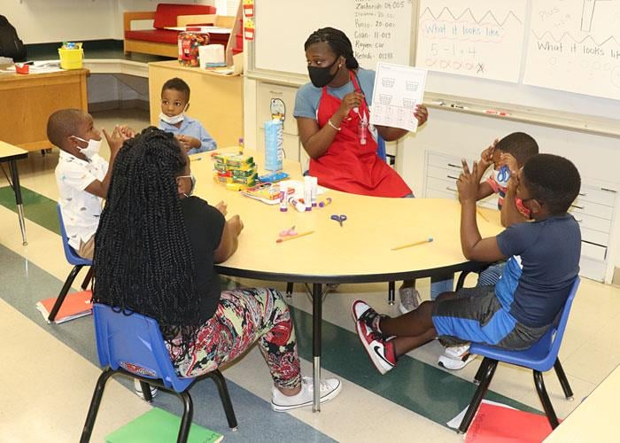
Acceleration of Learning
Provide high-quality instruction at grade level
Analyzed assessment data was to determine
levels of support needed
Implementation Methods
Scaffolding Supports
Use of prior knowledge to build understanding
Vocabulary Strategies
Explicit vocabulary instruction to build vocabulary and make connections
Writing Strategies
Journal writing, text-based writing

Slide 24
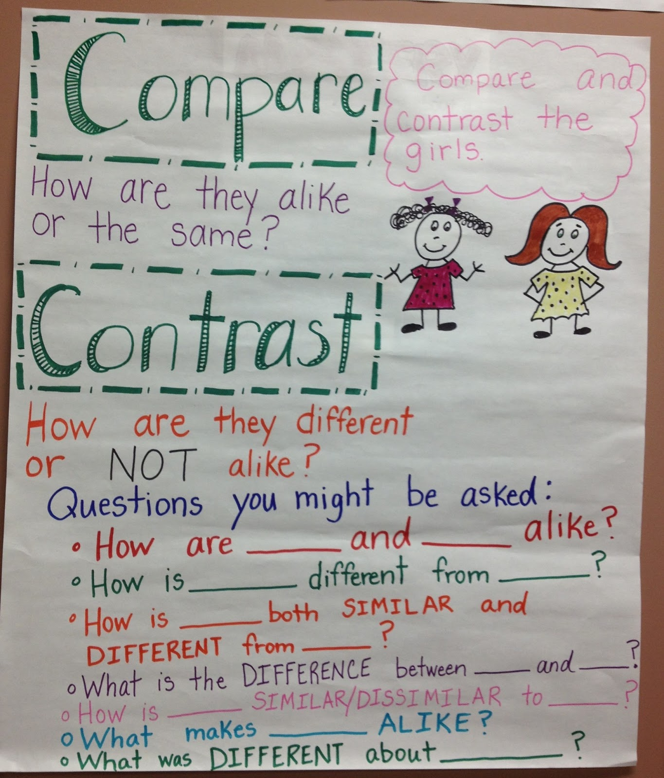
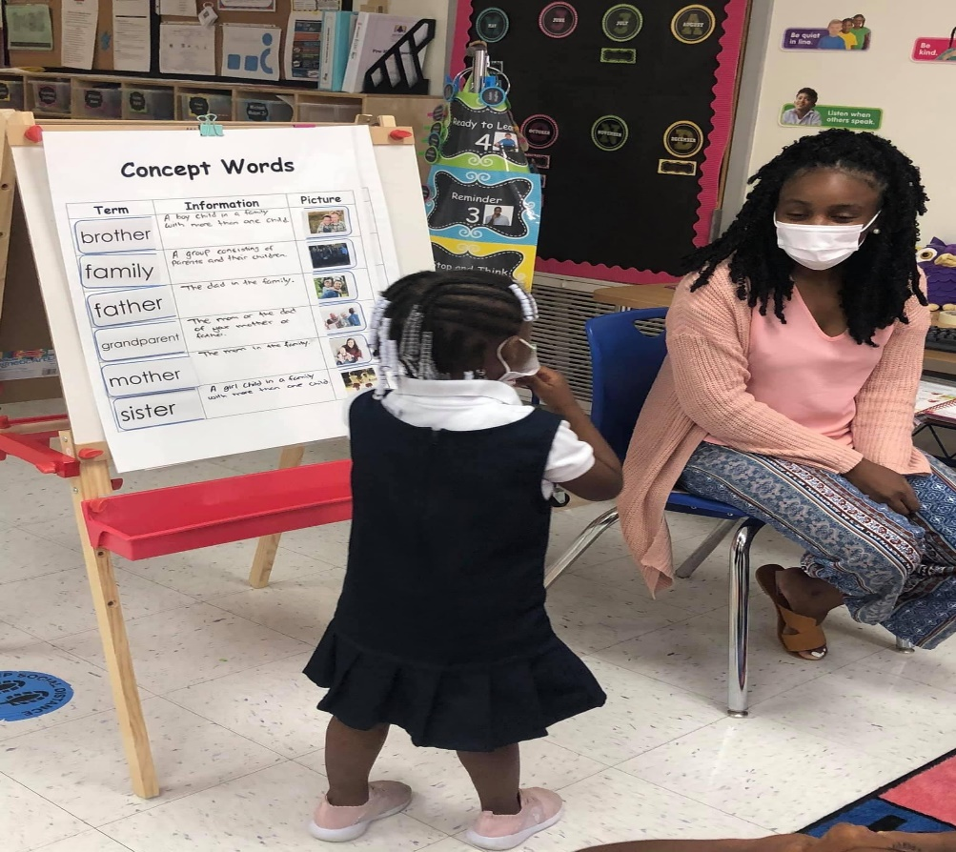
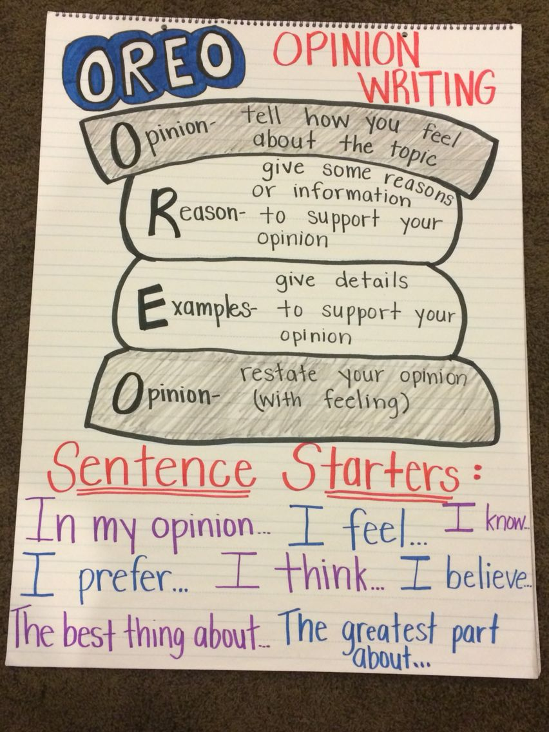
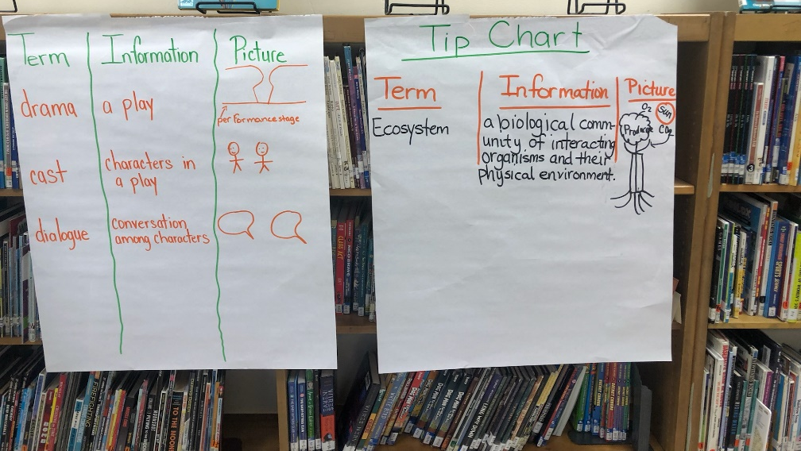
Scaffolding Supports
Vocabulary Strategies
Writing Strategies
Van Winkle Pre-K Center
Wells APAC

Slide 25
Balanced Assessment System
Provide multiple ways to assess student understanding
Methods of implementation
Formative assessments
Checks for understanding
Exit tickets
Questioning
Performance-based assessments
Project-based assessments
Summative assessments

Slide 26
Culture of Observation and Feedback
Provide multiple opportunities for students, teachers, and leaders to improve their learning/practice
Method of implementation
A.I.C. Protocol
Affirming the action
Discuss the Impact
What Challenges the actions for improvement or needs to Continue
Immediate and actionable

Slide 27
Professional Learning Opportunities

Slide 28
Monthly Professional Learning
Aligned instructional priorities to the core instructional resources
Aligned teacher and school leader district-level professional development
Continuous monitoring, coaching, demonstration and modeling of instructional best practices and effective implementation of core resources
Review of evaluation data to help refine professional learning opportunities

Slide 29
Professional Learning Calendar Excerpt
Date and Intended Audience | Session Title | Session Outcome
September 21, 2021 Audience: Trainers from Each School | Monitoring and Maintaining Fidelity to Daily Instructional Routines | Observe classroom instruction utilizing the teacher’s lesson plan & Classroom Observation Protocol (COP) Identify 1-2 prioritized, bit-sized action steps related to acceleration practices and/or checks for understanding (assessment) and plan the feedback conversation with the teacher Role play offering prioritized feedback to the teacher.
September 23, 2021 Audience: School Leaders | Providing a Coherent Sequence of Learning through High Leverage Instructional Routines | Utilize stages of the learning process such as teacher modeling/facilitating, concept development, checks for understanding throughout the lesson, and multiple opportunities for student practice Evaluate video instructional clips for examples of effective instructional routines and missed opportunities to develop student understanding;

Slide 30
From PD to Implementation Flow Chart
District-Level Professional Learning Activity
School-Level PDs
(large groups)
School-Level PLCs
(small group)
Review Data to Determine Next Steps
Monitoring, Coaching, Modeling
and Demonstration Lessons
Monitoring, Coaching, Modeling
and Demonstration Lessons
Monitoring, Coaching, Modeling
and Demonstration Lessons

Slide 31
Voices from the Field

Slide 32
Any Questions?

