Slide 1
2022-2023 Goals & Priorities
Dr. Michael L. Cormack, Jr.
Deputy Superintendent
August 16, 2022
Errick L. Greene, Ed.D.
Superintendent

Slide 2
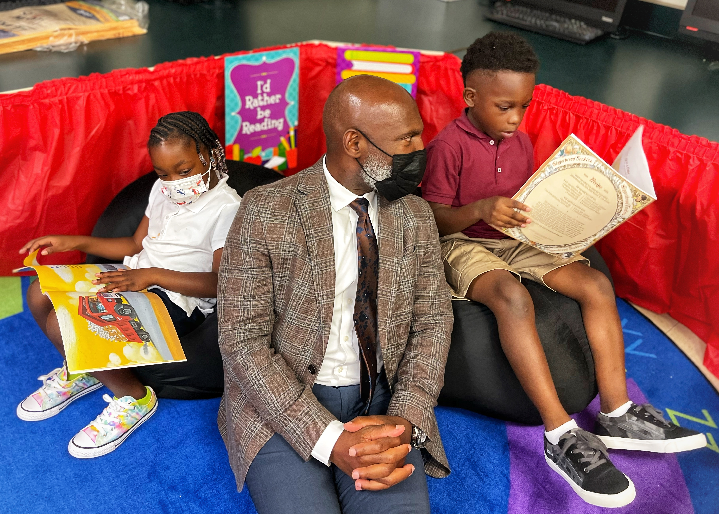
Welcome back JPS Scholars!
We launched the 2022-2023 school year last Monday, August 8th.
This year, we will maintain 3 instructional priorities or what we call our ABCs.

Slide 3
JPS Instructional Priorities (ABCs)
Acceleration
Balanced Assessment
Culture of Observation
Notes:
1 min

Slide 4
Each principal is setting Academic & School Climate goals!
1. Academic Achievement
(MAAP Proficiency & Growth)
2. School Climate
(JPS Thrive)

Slide 5
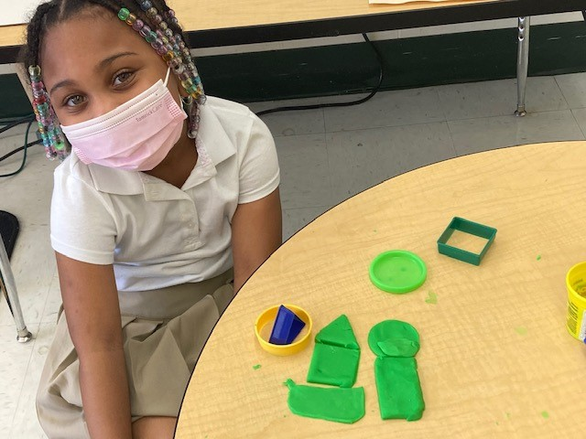
What would it take to ensure all JPS scholars THRIVE?
Notes:
Wha

Slide 6
Targeted Outcomes
Milestone: “Parents and families express overall satisfaction with their scholar’s school”
Measurement: Comprehensive Needs Assessment Survey
Notes:
1

Slide 8
Each principal is setting Academic & School Climate goals!
1. Academic Achievement
(MAAP Proficiency & Growth)
2. School Climate
(JPS Thrive)

