Slide 1
Jackson Public Schools Board of Trustees Meeting
August 17, 2021
5:30 p.m.
Errick L. Greene Ed.D., Superintendent

Slide 2
Our Agenda
Call to Order
Establishment of Quorum
Adoption of Agenda
Reading and Approving Minutes
Superintendent’s Report
Public Participation and/or Proposed Policy Issues
Information Only Items
Information/Action Items
Consent Agenda Items – Finance
Consent Agenda Items - General
Consent Agenda Items – Personnel
Consideration to Hold Executive Session
Adjourn

Slide 3
Items I-IV: Dr. Ed Sivak, Jr.
Board President
Call to Order
Establishment of a Quorum
Adoption of the Agenda
Reading and Approving Minutes

Slide 4
Item V: Superintendent’s Report Errick L. Greene. Ed.D.

Slide 6
Item V: Superintendent’s Report Errick L. Greene. Ed.D.

Slide 7
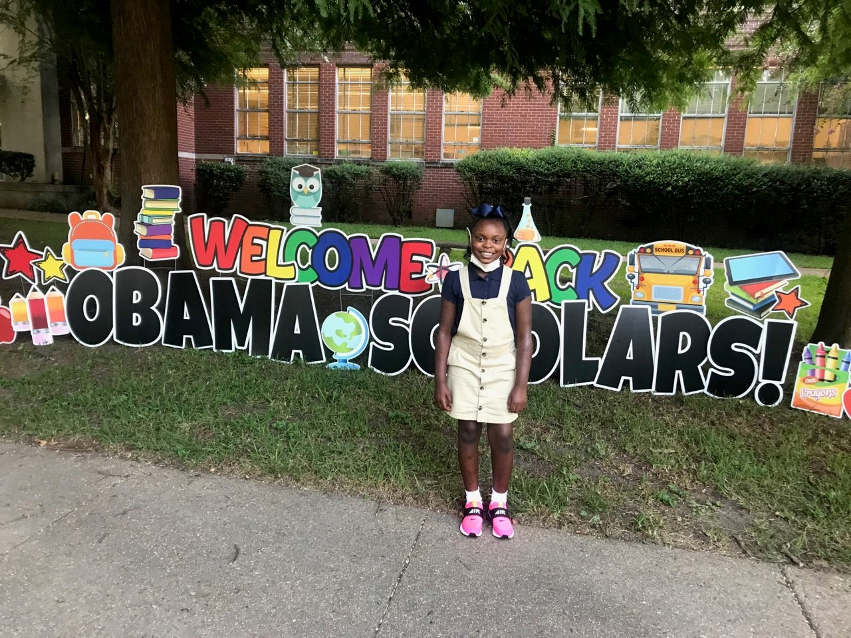
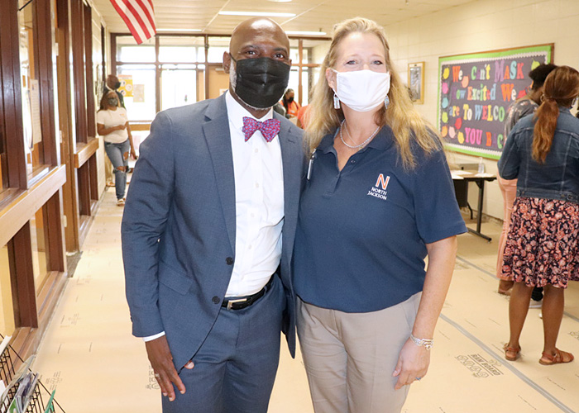
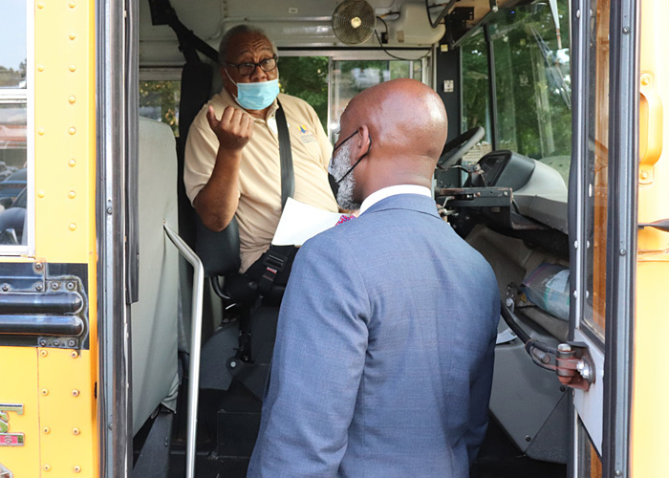
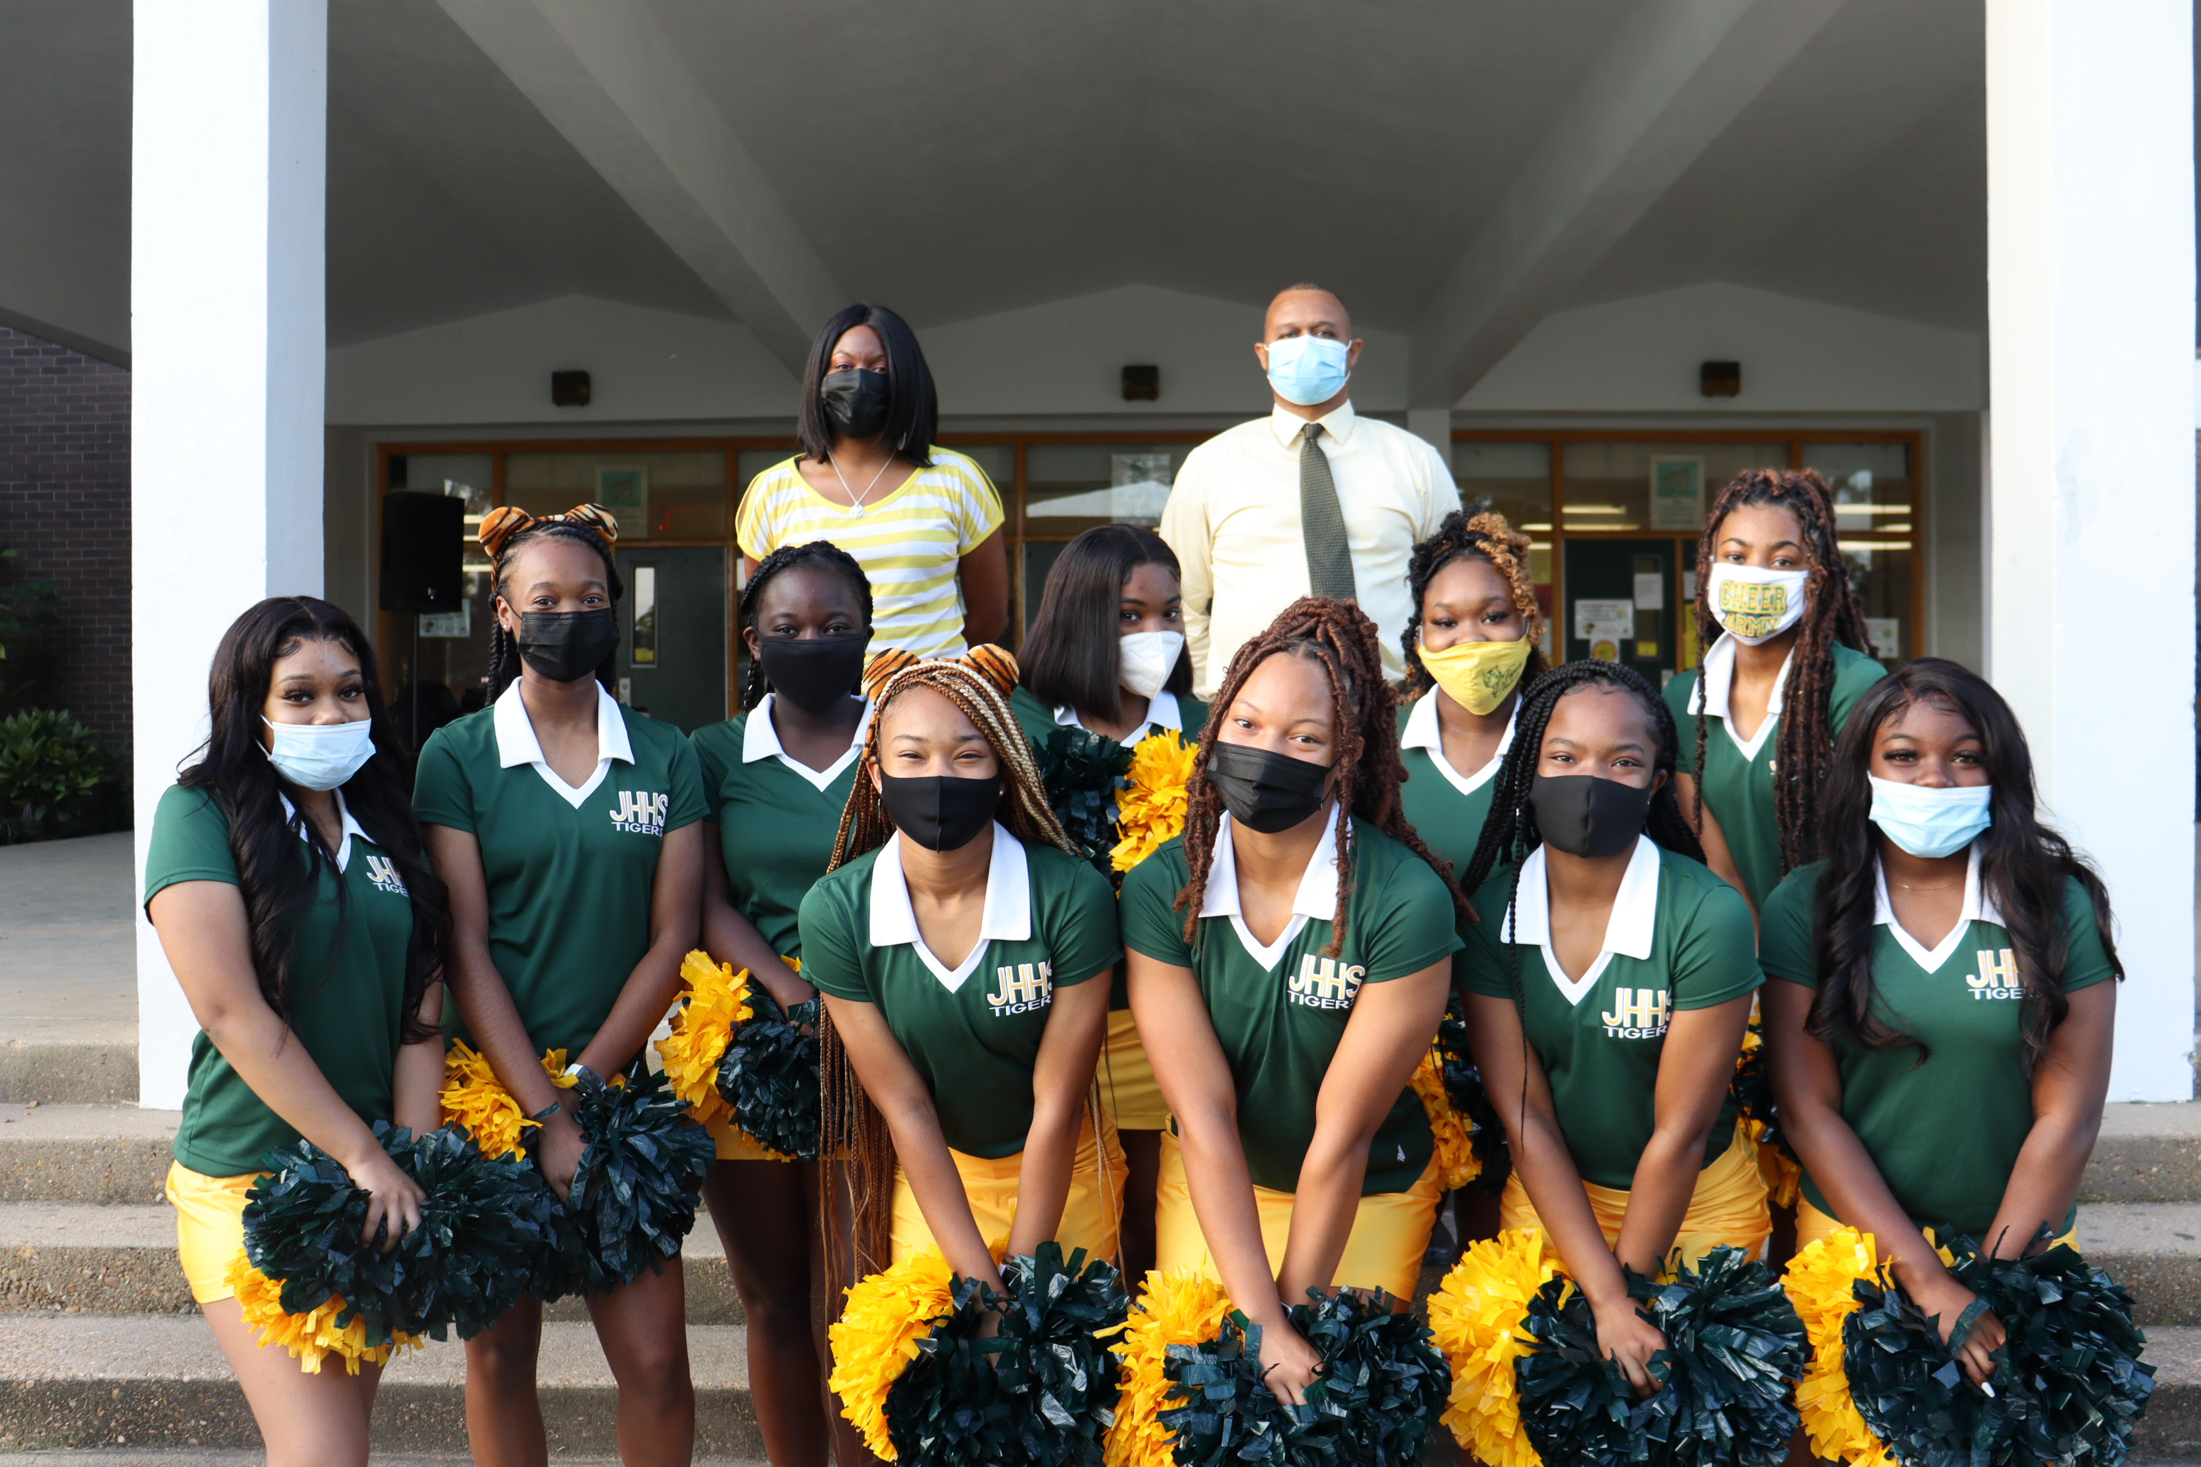
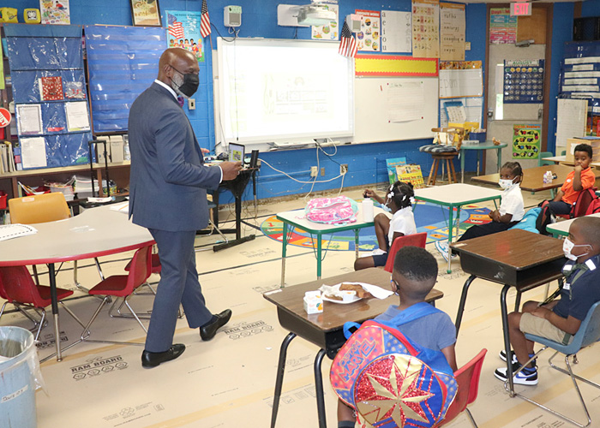
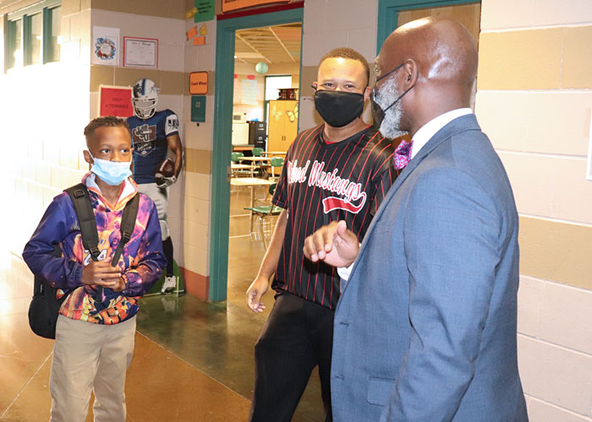
FIRST DAY OF SCHOOL

Slide 8
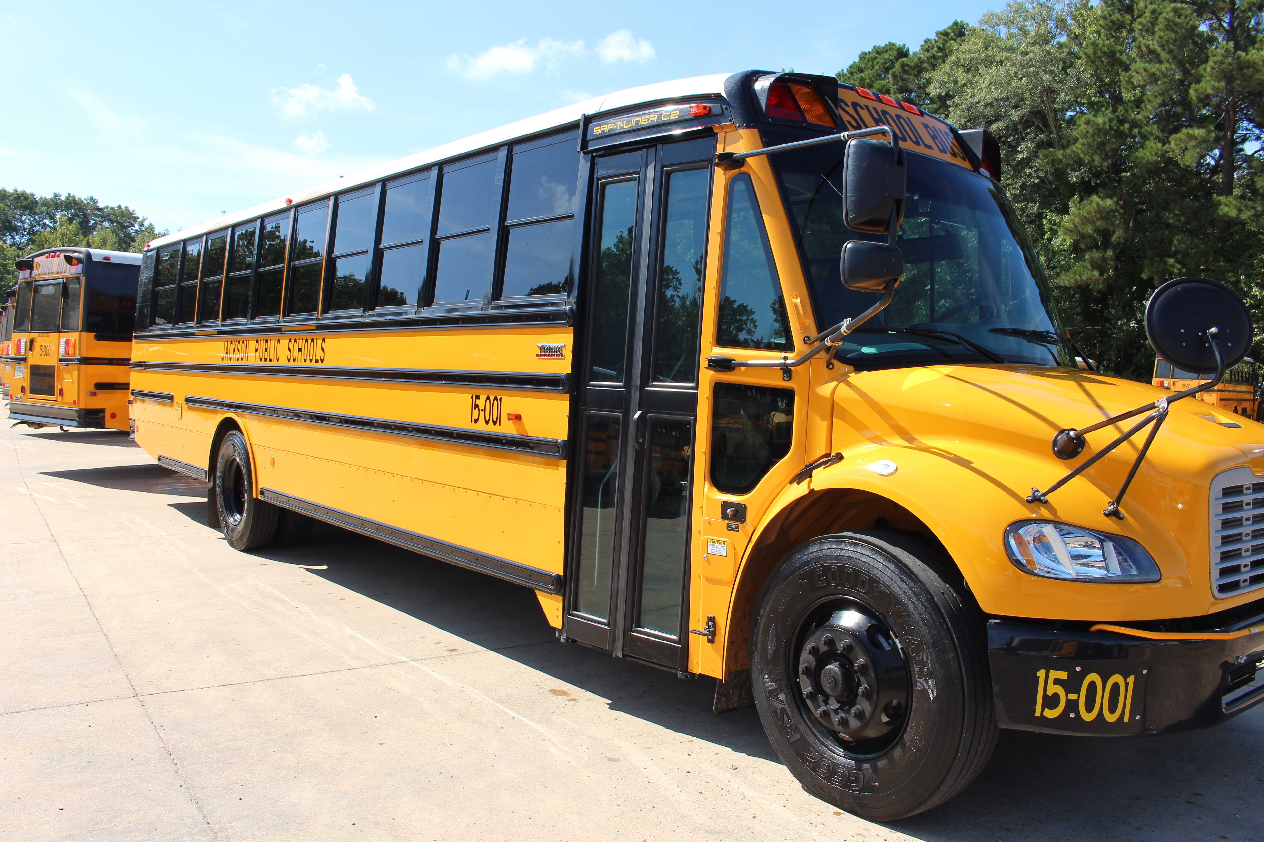
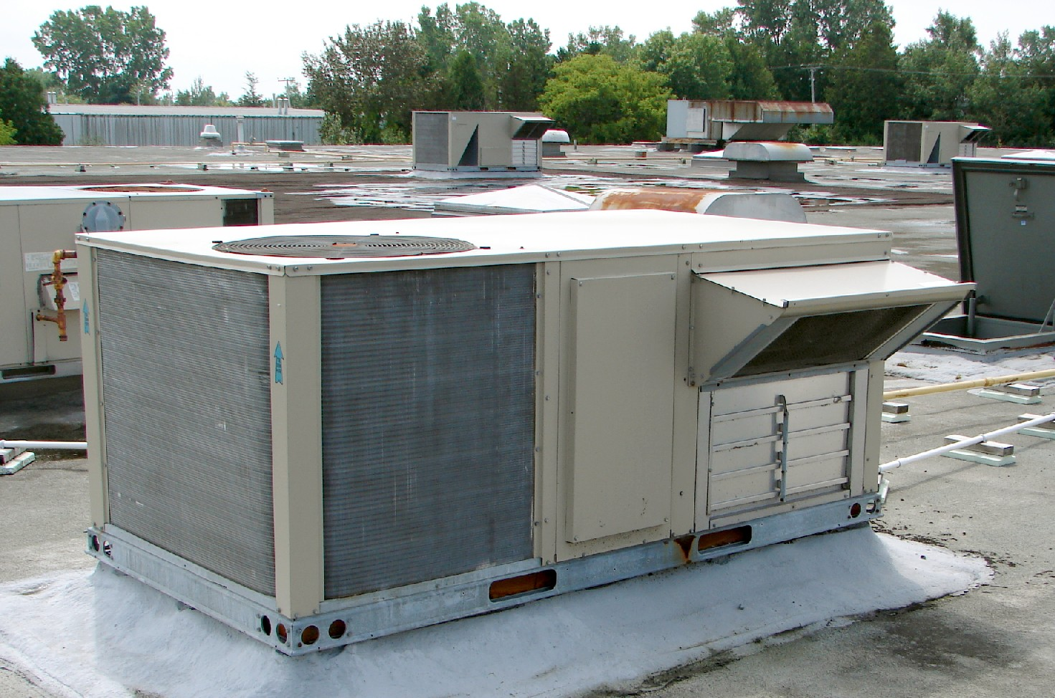
This Photo by Unknown author is licensed under CC BY-SA.

Slide 9
RETURN TO LEARN & COVID-19

Slide 11
COVID-19 DASHBOARD

Slide 12
FIRST DAY OF SCHOOL

Slide 13
This Photo by Unknown author is licensed under CC BY-SA.

Slide 14
RETURN TO LEARN & COVID-19

Slide 16
COVID-19 DASHBOARD

Slide 17
Item VI: Public Participation for General Comments and/or Proposed Policy Issues

Slide 18
Item VII: Information Items Only:
Review to Award RFP 2021-10 of Translation, Transcribing, and Interpreting Vendor, Cal Interpreting and Translation (CIT) Rajeeni Scott, Ph.D., Executive Director | Office of School Support

Slide 19
Item VIII: Information/Action Items
Approval of District to District Transfer (Incoming/Outgoing) (Dr. Griffith)
Approval of Bid 3192 – Chromebooks, Laptops, and Desktop Computers (Erin Mason, ED Information Technology)
Approval to Award RFP #2021-03 the Agreement between William Carey University and the Jackson Public School District (JPSD) Tommy Nalls, Jr. Ed.D., Director of Recruitment
Approval to Award of RFP #2021-07 K-12 Core Curriculum Digital Resources (Dr. Smith, ED Office of Teaching and Learning)
Approval of the Agreement between the Mississippi Symphony Orchestra (MSO) and the Jackson Public School District (JPSD) (Dr. Smith, ED Office of Teaching and Learning)
Approval of Agreement with RFP 2021-08 Advanced Instructional Management (AIM) and Jackson Public School District (JPSD)(Dr. Smith, ED Office of Teaching and Learning)
Approval of Amendment of the Job Description of McKinney-Vento Manager (Homeless) Dr. Merritt, Chief of Staff
Approval of Agreement between AMR Company: Mobile Medic Ambulance Service, Inc., d/b/a American Medical Response (AMR) and the Jackson Public School District (JPSD) Coach Jones, ED of Athletics
Approval to Rescind the Contract between Jackson Public Schools and J. Walker and Company, APC for Audit Services and to Award a One-Year Contract to Fortenberry & Ballard, PC for the Annual Audit for Fiscal Year ended June 30, 2021 (Margaret Purnell, Interim Chief Financial Officer)
Approval of Donations (Margaret Purnell, Interim Chief Financial Officer)

Slide 20
Item IX: Consent Agenda Items – Finance (Margaret Purnell, Interim CFO)
Approval of Recommendation to Disposed of Surplus Property
Approval of the Accounts Payable Claims Docket and the Ratification of the Travel Claims for the Period of July 24, 2021 through August 6, 2021
Approval of Various Bids
Approval of Single Source Award to Hatch Solutions for WePlaySmart tables
Approval to Award Contract Adjustment Change Order #1 (Add $40,000) for the Lanier High School Building Facade and Door Improvements
Approval to Award Contract Adjustment Change Order #1 (Credit $8,383.46) for the Green Elementary School Renovations
Approval to Reject Bid 3194 Wells APAC

Slide 21
Item X: Consent Agenda Items – General
Approval of Agreement between Cayen Systems and the Jackson Public School District (JPSD)

Slide 22
Item XI: Consent Agenda Items – Personnel
Approval of Staff Personnel Matters (Saundra Lyons)

Slide 23
Item XII-XIII: Consideration to Hold an Executive Session & Adjournment

Slide 24
For the Latest Information
Visit our website at www.jackson.k12.ms.us.
Like Us on Facebook, Follow Us on Twitter, & Subscribe to Our YouTube Channel.

