Slide 1
Partners in Education Community, Parent and Family Engagement

Slide 2
Collaborations and Partnerships
Child Nutrition Reading and Math Corps
Office of Teaching and Learning New York Life’s Grief Share
JPS Summer Reading Program MS Food Corps
JPS Summer Camp Hartford’s Fire Safety Program
30+ Induction Ceremony Parents for Public Schools
JPS Pre-K Parent Academy Visit Jackson
Digital Magic Program Two Museums
Get2College New Stage Theatre
Global Citizenship Initiative MS Food Network
Greater Jackson Arts Council Downtown Rotary Club

Slide 3
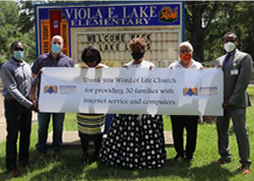
In-Home Instructional Supports

Slide 5
Fall, 2020
Parent and Family Engagement Workshops
September: Parental filters, stranger danger, online threats, i.e., cyberbullying, viruses and click bait. (PPS- national)
October: Tips to Encourage Reading at Home: AR, MyON (OTL)
November: Local Authors Café
December: STEM & Art Projects at Home (Women’s Engineers Assoc.)
Mississippi Children’s Museum- “Journey to the North Pole”
Marion Counseling Services, Choices for Children, Holiday/Family traditions
September: Parental filters, stranger danger, online threats, i.e., cyberbullying, viruses and click bait. (PPS- national)
October: Tips to Encourage Reading at Home: AR, MyON
November: Local Authors Café
December: STEM at Home- Ways to teach science at home, using everyday things around the house. Art Around the Home -Mississippi Children’s Museum- “Journey to the North Pole”, guests will explore the museum’s holiday village which includes magical train cars, letter writing station, the Reindeer Rink sock skating rink and more.
Marion Counseling Services, Choices for Children, Holiday/Family traditions

Slide 6
Spring, 2021 Parent and Family Engagement Workshops
January: College and Career Planning (Get2College)
February: Raising Readers Parent Workshop (Arise2Read)
March: Family Financial Fun Night- (MS Council Economic Education)
April: STEM + Family Night (Young Futurists, Women in Engineering)
May: Summer Reading Workshop (MS Food Corp and OTL)

Slide 8
Get2College Center

Slide 9
Major Initiatives Teacher Mini-Grants ● Emergency Supports

Slide 10
Major Initiatives City of Jackson Water Crisis

Slide 11
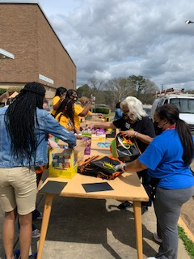
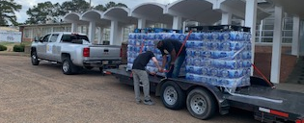
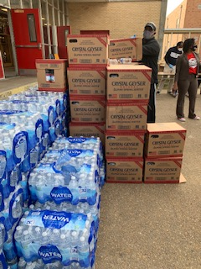
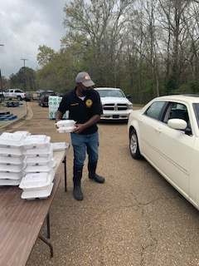
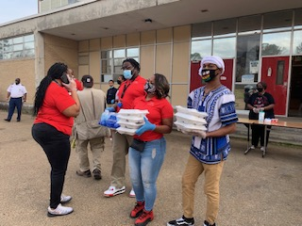
Major Initiatives City of Jackson Water Crisis

Slide 12
Morrison Elementary Alumnus, Kenya Collins Food Corp, Co-Director of National Programs

Slide 13
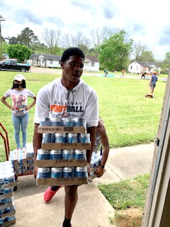
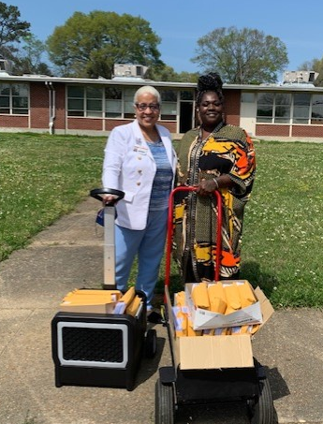
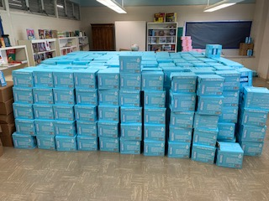
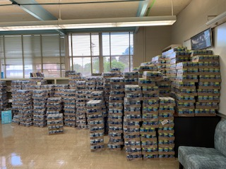
Major Initiatives MS Food Corps

Slide 14
Successes and Recognitions

Slide 15
MS Association of Partners in Education
2021 Governor's Award District Level
Jackson Public Schools and Partners in Education
High School Level
Lanier High School and LHS National Alumni Association
Elementary School Level
Obama Magnet School and Community Partners
Pandemic Partnership Response
Jackson Public Schools and Partners in Education
Obama Magnet School and Community Partners
William Carey University School of Education and Community Partners*

Slide 16
2021 Partnership Excellence Award
Middle School Level
Chastain Middle School and Community Partners
Elementary School Level
Baker Elementary School and Community Partners
Obama Magnet School and Community Partners - Playground
Spann Elementary School and Community Partners
Pandemic Partnership Response
Baker Elementary School and Community Partners
Chastain Middle School and Community Partners
Spann Elementary School and Community Partners

Slide 17
Community Leaders Meeting Tuesday, May 25, 6:00 p.m.
Faith-Based, Community and Business Leaders
Dr. Errick L. Greene and other JPS Team Leaders
Topics:
Overview of the 2020-21 SY
Planning for the 2021-22 SY
Registration

Slide 18
Districtwide Beautification Project
July 30, 8:00 a.m. to 1:00 p.m.
Central office Team Members and Community Partners
Northwest Blackburn Cardozo Walton

Slide 19
Evaluation for Growth Opportunities
Friday, May 28, 2021

Slide 20
Partners in Education Evaluation & Assessment
Keep It Up
Zoom workshops
Add this
Increased deliberation with our ELL families
Produce 5 minutes videos on helpful topics for parent and families, with assistance from our community partners
Change it or drop it?
Revise the Highlight awards

Slide 21
Questions?

