Slide 1
Term 1 Updates & Reflections
Superintendent’s Report
JPS Board of Trustees Meeting
Thursday, November 4, 2021

Slide 2
Our Core Values
Equity
Excellence
Growth Mindset
Relationships
Relevance
Positive & Respectful Culture

Slide 3
Agenda
Our ABCs – Attendance, Behavior, Course Performance
School-Home Communication
Parent & Family Engagement Opportunities
Questions & Answers

Slide 4
1st Quarter
Our first quarter began on August 9, 2021 and ended on October 12, 2021.
Midterm progress reports were issued on September 10, 2021.
Report cards were issued to all JPS scholars on October 18th, 2021.

Slide 5
Average Daily Attendance = 92.06%

Slide 6
Quick Facts About JPS Virtual Option
Initially, 1,533 scholars changed their instructional option to virtual. Today, 1,025 students have remained in virtual instruction, a decrease of 33% in virtual enrollment since September 7th.
JPS Families with scholars in grades PK-6th grade were offered a virtual instructional option. These scholars were afforded this option because they are currently ineligible for the COVID-19 vaccine.
The Average Daily Attendance (ADA) for our virtual scholars is 92.2%, slightly higher than our overall district ADA of between 89-90%.

Slide 7
Opportunities & Challenges
+
Principals are collaborating to offer feedback to their virtual educators who may be serving students across schools (Elementary). All middle schools were able to accommodate their virtual classrooms within existing school teams. Teachers are able to work with virtual scholars exclusively, rather than simulcasting, or teaching both in-person and virtual scholars simultaneously. School teams have hosted Virtual Family Nights to review expectations, meet any new teachers, and develop a positive working relationship. | Students are experiencing some attention and focus issues due to the extended time online (330 minutes). Frequent reminders to keep video screens on, especially after lunch. There are some ongoing connectivity challenges as some scholars do not have reliable internet services. There is a continued need for teacher professional development in the use of instructional technology and engagement techniques.

Slide 8
ADA for Month (Elementary – Div. 1)

Slide 9
ADA for Month (Elementary – Div. 2)

Slide 10
ADA for Month (Middle Schools)

Slide 11
ADA for Month (High Schools)

Slide 12
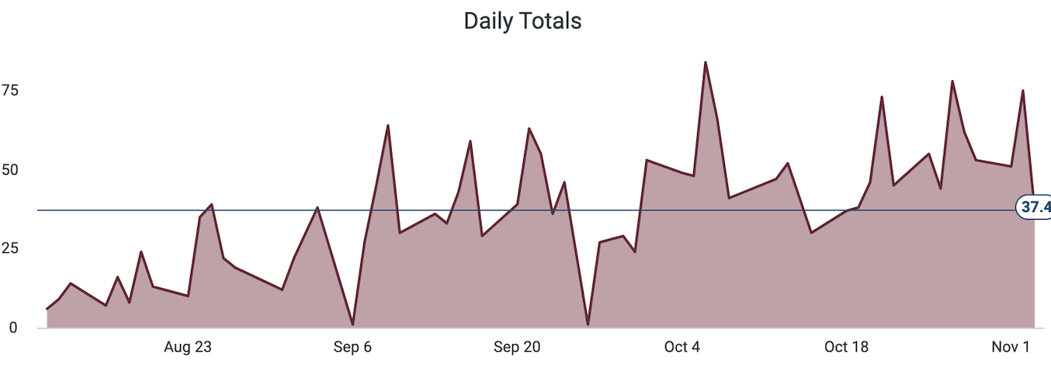
Behavior
Our number of behavior infractions is down below pre-COVID levels (school year 18-19).
The top 5 infractions this year include:
Disrespect Against Others
Truancy
Fighting
Classroom Disruption
Dress Code Violation
We have adopted a new Social Emotional Learning curriculum to continue proactively teaching pro-social behaviors.
Notes:
Grigsby

Slide 13
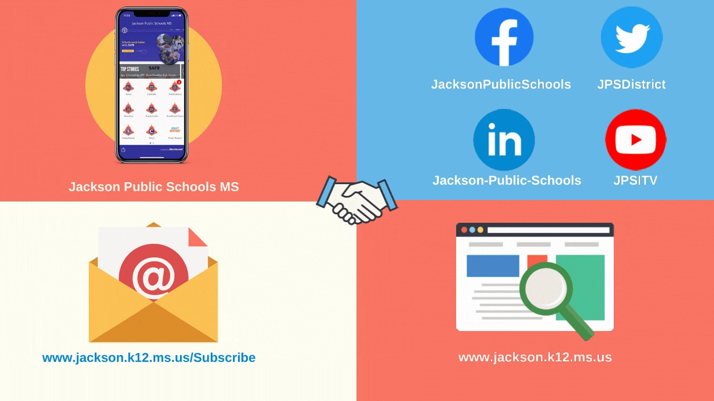
School-Home Connection
We encourage our parents and families to stay connected with their scholars’ schools in the following ways:
School Status – Engagement (two-way text messaging and phone calls)
JPS App – Available on Android & iPhone
Social Media – Facebook, Twitter, & Instagram
District & School Websites
Email Newsletter

Slide 14
Family Engagement Activities
Elementary – Parent Academy (PK/K)
Next Session is November 15, 2021
Middle – Navigating Middle School
High Schools – Get 2 College Parent Session, High School Parent Academy (Counseling)

Slide 15
Upcoming: This Month
3rd Grade Literacy Based Promotion Act - Information Sessions
Bates Elementary
McWillie Elementary

Slide 16
Key Takeaways
Our team members are excited to have scholars back in the building for in-person instruction. Our group virtually enrolled PK-6 scholars is steadily declining as parents opt to bring them back into the in-person format.
Report cards have been issued for the first nine weeks and the next progress report November 12th.
Attendance is in-line with pre-pandemic levels, and we are working with schools to improve their ADA where it falls below the district or divisional average.

Slide 17
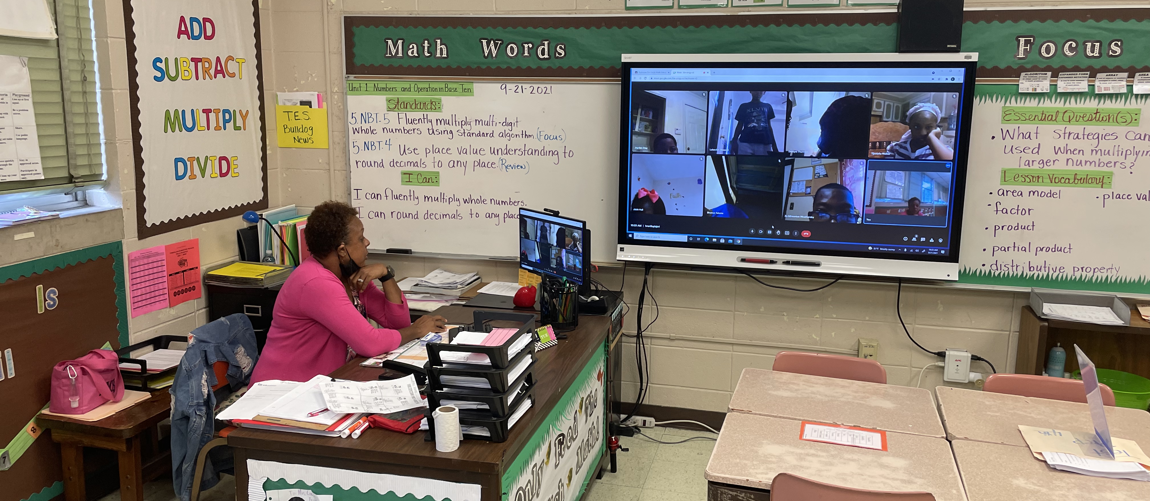
Questions & Answers
Ms. Robinson
Timberlawn Elementary
5th Grade Math – Virtual Instruction

